Slide 1
Software Project Management
Lecture 07:
Software Project Planning

Slide 2
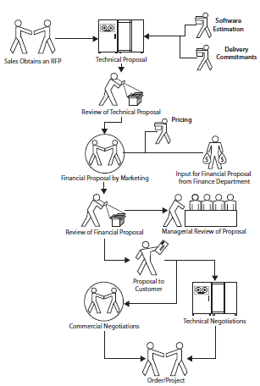

Slide 3
Plans Prepared in Software Project Management
Common Myth is “schedule constitutes software project planning.”
Actually, Software project planning (SPM) goes far beyond scheduling.
Several plans are typically prepared for a large software development project.
Project management plan.
Configuration management plan.
Schedule.
Induction training plan.
Risks management plan.
Deployment plan
User training plan.
Handover plan.
Software maintenance plan.

Slide 4
Project management plan
PMP is the top-level plan that consolidates all of the relevant information about a project, from the purchase order to the initial estimates and requirements, into the plan.
The PMP also incorporates
the methods that will be used for managing the project,
the project management tools to be used,
the project milestones,
The communication protocols,
The mechanisms for escalation and issue resolution.

Slide 5
Sub-Section of PMP
Resources:
Once a project has been estimated, a work schedule for execution of the project can be developed.
The work schedule provides details of the resources required and the dates when the resources will be needed.
Skills Set
In addition to the software project manager, several roles are typical, such as
(programmer, DBA, Team Leader, Software tester, Language Smiths, Software architect, business analyst, configuration controller, process coordinator, UI Designer, Quality Manager)
Computer System
Depending on the nature of the project, a project team needs various hardware items for execution of a project execution

Slide 6
Sub-Section of PMP Cont….
Project Management Method
number of methods may be used to manage a project
Project management methods include
Work allocation: to execute the tasks. Then progress reporting is done at the task level. Work allocation may use a variety of vehicles: an Excel sheet, Microsoft Project or Primavera scheduling tools, or PMPal, a work breakdown structure (WBS) collaboration tool. Work allocation may also be performed using a tool such as Microsoft Project Server, in a formal email, and by telephone or even in person.
Progress measurement and review: tools and methods are used to ensure that the status of a project is clearly understood. techniques include earned value analysis (EVA) and line of balance (LOB). A weekly status report is the most common progress reporting vehicle for projects.
Communication: Meetings, emails, and telephone calls are the most frequently used mechanisms for communication within and outside a project team. The communication plan in the PMP should cover
several scenarios:
• Communicating within the project team
• Communicating work allocation and completion dates
• Progress reporting
• Communicating with the client
• Communicating with project support groups

Slide 7
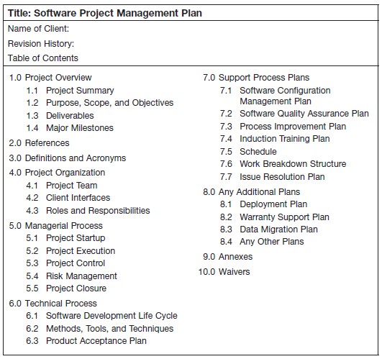

Slide 8
Configuration management plan
Software development project has several configurations:
Development: Arrangement of hardware and software for developing software. configuration plan typically has two distinct parts:
Code: the source code being developed
Information/documentation: information received from the client (requirement specifications, design, test plans, test cases, etc.); and generated by the project (test and review logs).
Review/Testing:
Integration: Integration is the process that receives software components and integrates them into the build of the product
Delivery: delivery configuration is the arrangement for delivery of the software components to the client (software build, source coede, libraries, user documentation and training manuals etc)
Deployment:
Obsolete artifacts: Obsolete artifacts are not destroyed — at least not until a project is complete. A simple approach to managing artifacts is to create three folders:
Current: all relevant, active artifacts that are complete and which will be referred to when needed
Archives: all previous versions of artifacts
In process: all artifacts that are being developed/revised

Slide 9
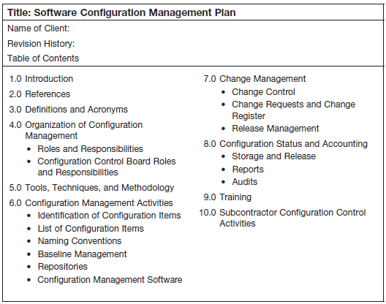

Slide 10
Quality Assurance Plan
Quality assurance planning focuses on achieving the specified level of quality of
the artifacts to be produced by a development team. A QAP usually contains:
Standards to be used in the project
Quality goals for the project
Quality assurance and control activities to be implemented in the project:
Measures and the processes for measurement (Cover the defined quality levels, the periodicity of testing, and the reporting mechanisms.)
Schedules for proposed project audits
Process improvement activities
Progress reporting mechanisms for the status of quality assurance activities implemented in the project (for all concerned parties)

Slide 11
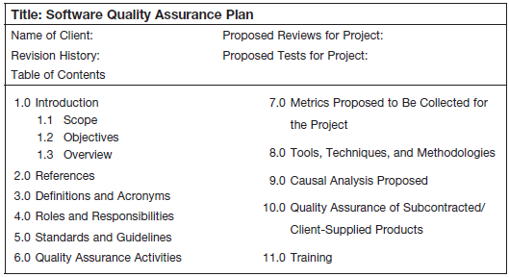

Slide 12
Schedule Planning
Scheduling planning is best achieved by using scheduling software
(e.g., Microsoft Project or Primavera).
WORK BREAK DOWN STRUCTURE

Slide 13
INDUCTION TRAINING PLAN
Describes how personnel are to be brought up to speed to ensure the highest level of efficiency for the project throughout its entire life cycle.
An induction training plan contains the training topics, duration of training, and the possible faculty for each topic needed by the personnel before beginning to work on the project.

Slide 14
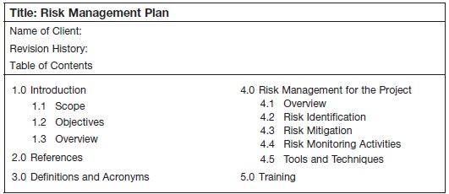
RISK MANAGEMENT PLAN
Risk management plan describes how risks will be identified, prioritized, and managed across the life of the project
Typical risk management activities include:
Risk identification
Risk quantification
Risk prioritization

Slide 15
Build Plan
Build plan contains the strategy for building the software project’s code and details the build period (ranging from continuous to daily or to some other period)
And how the build will be tested.
Details of the build plan include when and how functionality will be delivered to the client
A Typical Build Plan includes:
The approach for integration (i.e., top-down or bottom-up
Roles and responsibilities for preparing the builds
Configuration of the integration environment
Quality assurance activities before accepting components into the build environment
Quality assurance activities after integrating each component,
after integrating each module, and at completion of the build

Slide 16
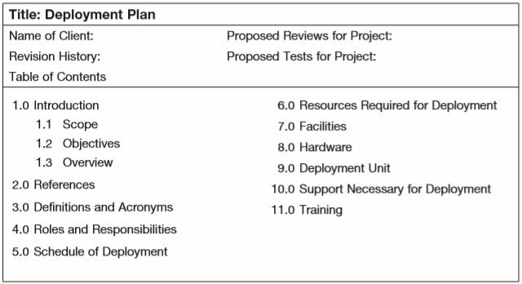
Deployment Plan
Deployment plan contains a description of the target location of the project’s functionality,
Including the deployment of hardware, system software, middleware, and pilot runs.
A deployment plan typically contains:
A schematic diagram of the deployment components, including hardware, software, networking, etc
Floor plans for deployment of hardware and networking (if necessary)
A bill of materials (lists all components being deployed along with the technical specifications of each of the components)
Quality assurance activities planned for deployment
Technical methods for deploying the configuration (if necessary)

Slide 17
User Training Plan
user training plan describes how users of the system will be taught to use the functionality being delivered.
A user training plan minimally contains:
A bill of materials (all components to be handed over to the client)
The mode of handover/takeover
The required sign-off details
A schedule for the handover

Slide 18
Software Maintenance Plan
software maintenance plan describes the activities, roles, and processes for the usual warranty period (sometimes, longer warranty periods may be requested; if so, a separate software maintenance project is usually spawned).
A software maintenance plan may contain:
The process for raising requests for software maintenance
Formats and templates for raising software maintenance requests
Service level agreements (including turnaround times for software maintenance requests)
The procedure for classifying software maintenance requests and prioritizing them
Issue-resolution mechanisms and escalation mechanisms during maintenance
The environment for software maintenance

Slide 19
Documentation Plan
Documenting of software project plans differs significantly from standard business writing
Software project plans are documents that are used by many individuals as a reference for guiding human efforts and for incurring expenditures
Attributes of an engineering drawing include
Unambiguous representation
One fact — one location
Specific language
Adhere to the documentation guideline
Avoid ambiguity

Slide 20
Pitfalls In Software Project Planning
Preparing only documents.
Best practice: Shift the focus from treating planning as documentation to using documentation as a tool to organize a project.
Inadequate time for planning
Best practice: Allow adequate time for planning activities — plan for planning.
No training or the wrong training.
Best practice: Provide formal training in PERT/CPM and other project management tools to individuals who are vested with the responsibility of planning.
Skipping reviews.
Best practice: Conduct peer and managerial reviews.
Lacking a PMO or having an ineffective PMO.
Best practice: Establish a robust and effective PMO based on a well-defined and well-implemented process framework.
Lacking a knowledge repository

